Slide 1
CSCI 1301 Introduction to Computing and Programming
Summer 2015

Slide 2
Basic Computation
Chapter 2

Slide 3
Java Class Structure
public class AJavaClass
{
public static void main(String[] args)
{
System.out.println("Hello World!");
}
}
Every Java Program has at least one class containing a main method.
The main method is what gets run when the program is executed.
The main method will in turn (likely) call other methods.

Slide 4
Program Execution
For the next few weeks, all of the statements you write will be in the main method of a single class.
The statements get executed one at a time, usually top-to-bottom.
public class SomeClass {
public static void main (String[] args){
// Statement 1
// Statement 2
…
// Statement n
}
}

Slide 5
Screen Output
System.out is a built-in Java object. Objects contain actions.
print() and println() are methods (actions) available to the System.out object (they print to the screen).
print() prints out whatever argument is given to it.
println() prints out its argument, and then moves to the next line.

Slide 6
Screen Output
System.out.print(”Hello ");
System.out.print(”CSCI 1301 ");
System.out.println(”Students! ");
How will the output look in the console?

Slide 7
Screen Output
It’s possible to have multiple arguments to the println method using “+”.
System.out.println("The count is " + 2);
Outputs the string literal "the count is ” followed by 2, all on a single line.
The cursor will then be placed on the next line.
Note: you can also put variables in a print statement (more soon)

Slide 8
Variables
Statements often involve variables.
A variable is a named memory location for storing data.
The programmer provides the name.
The data stored is called the variable’s value.
Example:
cost = 9.95;
Here, cost is a variable. 9.95 is its value.

Slide 9
Variable Assignment
The value of a variable can be changed.
cost = 1;
cost = 5;
cost = 62;
Each statement here assigns a new value to the variable.
‘=’ is the assignment operator. It doesn’t check for equality.
x = 5 doesn’t mean that x and 5 are the same.
x = 5, when executed, assigns the value 5 to x.

Slide 10
Literals
Literals are simple values that can be assigned to variables—for instance, 2, 300.7, or 'y'—are literals.
Integer literals can be preceded by a – sign.
Integer literals cannot contain commas.
Floating-point literals can be written
With digits after a decimal point (300.7) or
Using scientific notation (3.007e2).

Slide 11
Variable Declarations
In order to use a variable, it must first be declared.
In a declaration, you specify
the name of the variable, and
the type of the variable.
The type determines what values the variable can hold.
E.g., int numberOfDogs; is a variable declaration.
It specifies that numberOfDogs is a variable of type int.
ints represent integers.

Slide 12
Variable Declarations
The syntax of a variable declaration is given below.
type variable₁, variable₂ …, variable_{n}
type is the name of a type.
variable₁, variable₂ …, variable_{n} are chosen variables names.
Examples:
int numberOfStudents, numberOfPets;
double balance, weight;
char gender;
int, double, and char are all types.

Slide 13
Variables
View sample program
Class FootballFans

Slide 14
Variables
View sample program
Class FootballFans
Why was it good to use variables in this program?

Slide 15
Where to Declare Variables
Usually at the beginning of a method or “block” of code enclosed in {}.
public static void main(String[] args)
{ /* declare variables here */ . . . }

Slide 16
Java Identifiers
Variable names are Java identifiers.
An identifier is a word used to name something in the program (e.g., a variable, a method, a class, etc.).
Identifiers may contain only:
letters
digits 0-9
the underscore character: ‘_’
But they cannot contain other characters.
Also, the first character cannot be a digit.

Slide 17
Java Identifiers
These are valid identifiers:
x netscape _345 _
numStudents red9
Note: Java is case sensitive.
stuff, Stuff, and STUFF are different identifiers.
These are not valid identifiers:
7_11 netscape.com
util.*
Identifiers can be arbitrarily long.

Slide 18
Keywords/Reserved Words
Certain expressions cannot be used as identifiers
These are keywords or reserved words.
They have predefined meanings in programs.
Here they are:
abstract | continue | for | new | switch
assert | default | goto | package | synchronized
boolean | do | if | private | this
Break | double | implements | protected | throw
Byte | else | import | public | throws
case | enum | instanceof | return | transient
catch | extends | int | short | try
char | final | interface | static | void
class | finally | long | strictfp | volatile
const | float | native | super | while

Slide 19
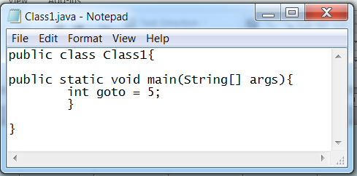
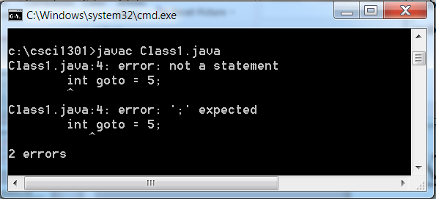
Keywords/Reserved Words
If you try to use a keyword as an identifier, then the Java compiler will generate an error.
The program will not compile.
int can’t be a variable name.
can INT?

Slide 20
Data Types
There are 2 basic kinds of data types in Java.
There are primitive types: used to represent simple values (numbers, characters, etc.).
int, double, and char are primitive types.
class types (reference types) are used for objects (which are not simple).
Primitive and class types are handled differently in Java.
Primitive types only take a few bytes to represent.
The objects used with class types may require arbitrarily large amounts of memory.

Slide 21
Data Types
When declaring a variable, one specifies a particular type, which will either be a primitive type or a class type.
Examples:
int count = 0; int is a primitive type.
String firstName = “Frank” String is a class type.
The declarations have the same form, but the kinds of values are different.

Slide 22
Naming Conventions
Primitive types begin with a lowercase letter (e.g. int).
Class names begin with an uppercase letter (e.g. String).
Variable names begin with a lowercase letter (e.g. myName, myBalance, age).
For multiword names, subsequent words are capitalized.

Slide 23
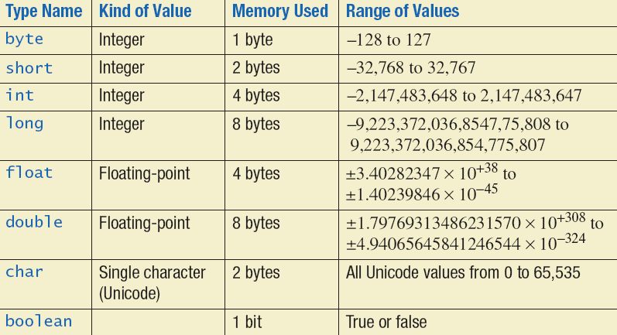
Primitive Types
There are only 8 primitive data types in Java:

Slide 24
Examples of Primitive Values
Four integer types (byte, short, int, and long)
int is most common
Ex: 0 -1 365 12000 5
Two floating-point types (float and double)
double is more common
Ex: 0.99 -22.8 3.14159 5.0
One character type (char)
'a' 'A' '#' ' ' '5'
One boolean type (boolean)
true false

Slide 25
Why the large range of values for types?
All modern computers work with a system of numbers called binary numbers.
Use only two symbols: 0 and 1.
Binary circuits: Electronic devices are cheapest and function most reliably if they assume only two states.
Your computer circuitry is made up of billions of transistors that can assume two states: 1 or 0 (on or off). Computers represent ALL data with a series of 1s and 0s
The transistor is like a mini light bulb – can be either on or off.

Slide 26
Binary Code
How many different things can we represent with only a single transistor?
What if we wanted to represent (count) everyone in this room using a single digit (0-9)?
I take the number 0, people on the first row take 1-9. What about everyone else?
Similar question: How can we represent all numbers using binary code?
Well, we have billions of transistors! We can combine 1s and 0s to get more combinations.

Slide 27
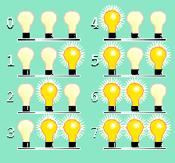
Representation of Numbers
One bit can represent 2 items, 3 bits can represent 8.
Three-light (binary circuit) system:
Has eight possible combinations of on and off.
We can create a mapping between each combination and a number: 0, 1, 2, 3, 4, 5, 6, 7.
0 = 000 4 = 100
1 = 001 5 = 101
2 = 010 6 = 110
3 = 011 7 = 111

Slide 28
Representation of Numbers
So, how was this particular mapping chosen, and what happens with numbers greater than 7?
Lets answer this with another question:
What thought processes are used in counting to 1000 from 999 in decimal numbers?
How did we know to add a new column?
How did we know which number comes next?

Slide 29
Representation of Numbers
Decimal
Each number has a unique representation.
Counting:
When you run out of digits, make it a zero and increment the next place value to the left.
99 becomes 100
Binary
Each number has a unique representation.
Counting:
When you run out of digits, make it a zero and increment the next place value to the left.
11_{two} becomes 100_{two}
Can you count to 15 in binary?

Slide 30
Another Question
1 byte is how many binary bits?
If 8 numbers can be represented using 3 bits, how many can be represented using 1 byte?

Slide 31
Representation of Numbers
Change the following binary number to decimal:
11010
What is the largest number that these 5 bits can represent?

Slide 32
Lets try a few more!
Convert the following to decimal:
01
110
10110
11010101
101010101

Slide 33
Did you get these answers?
1
6
22
213
341
How do we go from decimal to binary?

Slide 34
Primitive Types
So, why does the range change with each type?

Slide 35
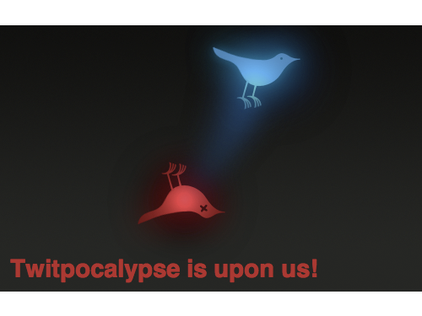
June 12, 2009
Twitter Crashes
The unique numerical identifier associated with each tweet exceeded the limit of 32-bit signed integers
2³¹ - 1 = 2,147,483,647 total messages
Image from http://appadvice.com/appnn/2009/06/twitpocalypse-affecting-twitterrific-others

Slide 36
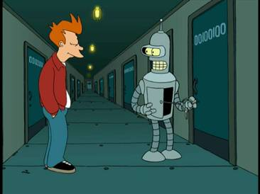
Bender’s Binary Apartment Number 00100100
What base-10 integer does this encode?
What ASCII character does this encode?
Image from Futurama (Matt Groening and David Cohen)

Slide 37
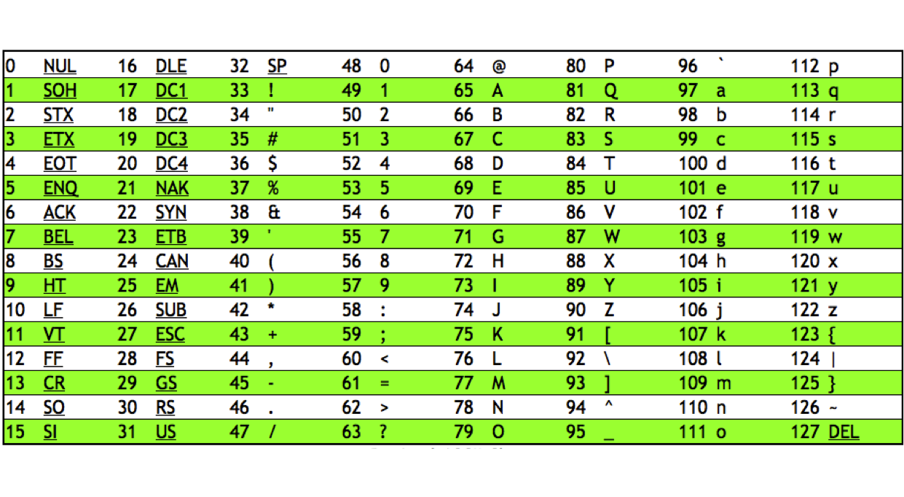
ASCII Chart
http://python2011.globalblogs.org/files/2011/09/ascii.png

Slide 38
Announcements
Lab assignment 1 due Jun 10th, 9PM.
Accepted without penalty until Jun 12th at 9pm. Missing a lab is a 25-point penalty!
Programming project 1 posted Jun 11th
Due Jun 19th, 9PM.
If submitting late, it is a 25 point penalty per day. The project will not be accepted after 2 days (Sunday Feb 1st, 9PM).
First in-class quiz next Week
Chapter 1 and section 2.1 plus class notes
Readings for this week: Ch 2.

Slide 39
Announcements
All Office Hours are posted online
You can go to any TA/instructor for help!
Get in the habit of going to lab!
You must show your TA and submit lab and project to leave early this week.
Lab assignment 1 graded by Jan 25th.
Rubric posted after grades are up

Slide 40
Announcements
Lab 2 due _________.
You must attend lab
Programming project 1 due Jan 30th.
Discuss

Slide 41
Why are there so many types?
One answer is efficiency. We know exactly how many bytes are used to store a short and what it can represent.
If the possible values for your data fall within the range of a short, then using a short uses less memory (more efficient).
Also, it allows errors to be caught by the compiler—it prevents us from adding apples and oranges (or int and boolean values);
More in a minute!

Slide 42
Assignment Statements
An assignment statement assigns a value to a variable.
answer = 42;
“=” is the assignment operator.
answer = 42; may be read as
“The variable named answer is assigned a value of 42,” or, “answer is assigned 42.”

Slide 43
Assignment Statements
Assignment statements have the syntax
variable = expression;
expression can be:
another variable,
a literal (which is?),
or an arithmetic or other complex expression.
The right-hand-side is evaluated, and the result assigned to the variable.
sum = (test1 + test2+test3)/3*0.20;
The left-hand-side is always a variable.

Slide 44
Assignment Examples
amount = 3.99;
firstInitial = 'W';
score = numberOfCards + handicap;
The right-hand-side is evaluated, and the result assigned to the variable on the left-hand-side.

Slide 45
The Scanner Class
We can also assign values based on user input
Input can be captured using the Scanner class.
To use it, you must add the following statement at the beginning of your source code file.
import java.util.Scanner;
at the beginning of the file.
To create an instance of the Scanner class to read from the keyboard (System.in), add the following statement:
Scanner myScanner = new Scanner(System.in);
To read an int value and assign it to a variable, call nextInt():
int myVariable = myScanner.nextInt();
Revisit FootballFans using Scanner and output formatting (\t, \n).

Slide 46
import java.util.Scanner;
public class FootballFans
{
public static void main(String[] args){
int numberOfRows, fansPerRow, totalFans;
Scanner keyboard = new Scanner(System.in);
System.out.println("Enter the number of fans in each row:");
fansPerRow = keyboard.nextInt( );
System.out.println("Enter the number of rows:");
numberOfRows = keyboard.nextInt( );
totalFans = numberOfRows * fansPerRow;
System.out.println("If you have");
System.out.println(fansPerRow + " fans per row and");
System.out.println(numberOfRows + " rows, then");
System.out.println("the total number of fans is " + totalFans);
System.out.println("Now we take two fans out of each row.");
fansPerRow = fansPerRow - 2;
totalFans = numberOfRows * fansPerRow;
System.out.println("You now have");
System.out.println(fansPerRow+ " fans per row and");
System.out.println(numberOfRows + " rows.");
System.out.println("The new total number of fans is " + totalFans);}
}

Slide 47
Announcements
Lab assignment 1 graded by Jan 25th.
Questions about grades go to Tas
Lab 2 due January 23rd by 9pm.
You must attend lab
Programming project 1 due Jan 30th by 9PM.
You must show your TA and submit lab 2 and project 1 to leave early this week.

Slide 48
Assignment Compatibilities
Java is said to be strongly typed.
You can't assign a float value to a variable declared to be an int, for instance.
Some assignments are OK, however.
These are:
int luckySeven;
double doubleVariable;
luckySeven = 7;
doubleVariable = luckySeven;

Slide 49
Assignment Compatibilities
A value of one type can be assigned to a variable of any type further to the right…
byte → short → int → long → float → double
But not to a variable of any type further to the left.
Why do you think this is true?
Those allowable are called widening conversions.
Can assign a value to a variable of a “wider type”.
You can also assign a char value to an int, long, float, or double variable.
What happens if you assign a char to an int? What value is stored in the variable?
What happens if we assign 598 to a char?

Slide 50
ASCII Chart
http://python2011.globalblogs.org/files/2011/09/ascii.png

Slide 51
Assignment Compatibilities
A value of one type can be assigned to a variable of any type further to the right…
byte → short → int → long → float → double
You can’t assign a long to an int or a float to an int.
What if we really want to store a float value in an int variable?

Slide 52
Type Casting
A type cast temporarily changes the value of a variable from the declared type to some other type.
double distance;
distance = 9.2;
int points;
points = (int)distance;
The assignment is illegal without the (int) .
Why is it necessary to cast when going from double to int but not when going from int to double?
Loss of precision!
Such a cast is called a narrowing conversion.

Slide 53
Type Casting Example
What if we do the following:
int x = (byte) 1024;
What about:
int x = (byte) 1026; ?

Slide 54
Initializing Variables
A variable that has been declared, but not given a value is said to be uninitialized.
Uninitialized class type variables have the value null.
Uninitialized primitive variables will have no default value.
int numberOfThingsLeftToDo;
System.out.println(numberOfThingsLeftToDo);
Without a separate assignment statement, this might cause a compile-time error.

Slide 55
Initializing Variables
To keep the compiler happy, assign a value at the time the variable is declared.
This is called initializing a variable.
Syntax:
type variable₁ = expression₁, variable₂= expression₂, …;
Examples:
int count = 0;
char excellent = 'A', good = 'B';

Slide 56
Named Constants
It is often useful to have a variable with a fixed value.
E.g., for mathematical or physical constants.
Java provides mechanism to declare named constants.
They are variables having the following declaration form:
public static final Type Variable = Constant;
They are initialized when declared.
By convention, uppercase letters are used to name them.
Example (Note: this line is placed outside of main but inside the class declaration):
public static final double PI = 3.14159;

Slide 57
Using Named Constants
Tip: Use name constants rather than literals:
area = PI * radius * radius;
is clearer than
area = 3.14159 * radius * radius;
Define constants at the beginning of the program.
In between the class declaration and main.

Slide 58
Named Constants
If a named constant is used in a program, its value can be changed simply by changing the declaration.
public static final double INTEREST_RATE = 6.65;
If a literal value is used in a program, changing it’s value requires changing every occurrence in the program.

Slide 59
Named Constants
Imagine a banking program with 100,000 lines of code for a bank with over 10,000 customers. This program computes the monthly interest on all savings accounts at the bank.
For each customer, the following line is executed:
Balance += Balance * 0.005;
So, there are 10,000 such lines in this program.
In September, the interest rate drops to 0.001. Uh oh…
If a named constant is used in a program, its value can be changed simply by changing the declaration.
public static final double INTEREST_RATE = 0.005;
If a literal value is used in a program, changing it’s value requires changing every occurrence in the program.

Slide 60
Strings

Slide 61
The Class String
There is a class defined in Java that’s called String.
It’s used to represent sequences (i.e., strings) of characters.
"Enter a whole number from 1 to 99."
In a program, text beginning and ending with "…" is a string constant.
It is a sequence of characters, but
Like other constants, it’s treated as a single item.
A string can be empty: "".
A variable declared to be of type String can store a string constant.
String greeting;
greeting = "Hello!";

Slide 62
String Constants and Variables
String is a class type. Its instances are String objects.
Like all class types, if it is not initialized, it defaults to ?
Once declared, a String object can be printed.
String greeting = "Hello!";
System.out.println(greeting);
A string variable can’t be used in a print statement until a value has been assigned.

Slide 63
Concatenation of Strings
The + operator can be used to concatenate two or more strings together.
Program
String message = "Open the pod bay doors"; String name = "Hal"; String sentence; sentence = message + ", " + name + ". "; System.out.println(sentence);
Output

Slide 64
Concatenation of Strings
The + operator can be used to concatenate two or more strings together.
String constants and variables can be mixed.
Program
String message = "Open the pod bay doors"; String name = "Hal"; String sentence; sentence = message + ", " + name + ". "; System.out.println(sentence);
Output
Open the pod bay doors, Hal.

Slide 65
Concatenating Strings and Other Things
The + operator can be used to concatenate String objects and other types of values.
The result of the operation is always a String.
Program | Output
String solution; solution = "The answer is " + 42; System.out.println (solution); | The answer is 42

Slide 66
String Methods
String is a class. Its instances are String objects.
Variables of type string are class types (not primitive types). What does this mean?
A String object stores a sequence of characters.
Unlike a primitive value, the sequence can be of varying length.
The String class defines several methods (actions).
The methods of String objects can be invoked (called).
The length() method returns the number of characters in a particular String object.

Slide 67
String Methods
Program
String message = "Open the pod bay doors"; String name = "Hal"; String sentence; sentence = message + ", " + name + ". "; System.out.println(sentence); System.out.println(sentence.length());
Output

Slide 68
String Methods
Program
String message = "Open the pod bay doors"; String name = "Hal"; String sentence; sentence = message + ", " + name + ". "; System.out.println(sentence); System.out.println(sentence.length());
Output
Open the pod bay doors, Hal. 29

Slide 69
The Method length()
The method length() returns an int.
You can use a call to method length() anywhere an int can be used.
Observe the ‘.’ notation used to invoke the object’s length() method.
int count = command.length(); //in an assignment System.out.println("Length is " + command.length()); //in a print statement count = command.length() + 3; //in an expression

Slide 70
String Methods
String objects have methods.
String constants are objects, too.
They have methods that can be invoked.
Program
System.out.println("This is a little odd.".length());
Output
21

Slide 71
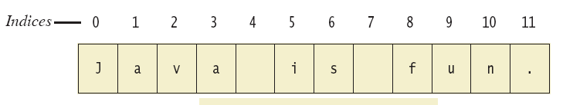
String Indices
A String is a sequence of characters.
Each character has an index (its position).
Positions start with 0, not 1.
The 'J' in "Java is fun." is in position 0
The 'f' in "Java is fun." is at index 8.

Slide 72
Substrings
A substring is a portion of the sequence of characters.
The substring "fun" begins at position 8.
Lets see some of the other methods in the String class
StringDemo.java

Slide 73
Announcements
Lab assignment 1, Quizzes 1&2 graded.
Questions about grades go to TAs
Rubric posted
Lab 3 due January 30th by 9pm.
You must attend lab
Programming project 1 due Friday by 9PM.
You must show your TA and submit lab 3 and project 1 to leave early this week.

Slide 74
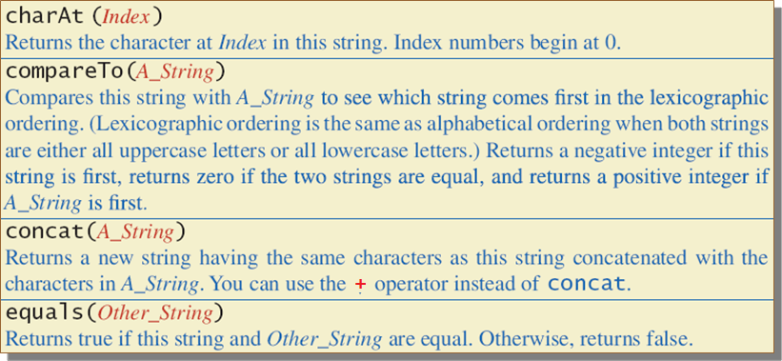
String Methods
The String class defines lots of methods.

Slide 75
String Methods
Program
String message = "Open the pod bay doors"; System.out.println(message.charAt(5)); System.out.println(“Hello”.compareTo(“Abcd”)); String newMessage = message.concat(”, Hal."). System.out.println(newMessage); System.out.println(“Hello”.equals(“Abcd”));
Output

Slide 76
String Methods
Program
String message = "Open the pod bay doors"; System.out.println(message.charAt(5)); System.out.println(“Hello”.compareTo(“Abcd”)); String newMessage = message.concat(”, Hal."). System.out.println(newMessage); System.out.println(“Hello”.equals(“Abcd”));
Output
t 1 Open the pod bay doors, Hal. false

Slide 77
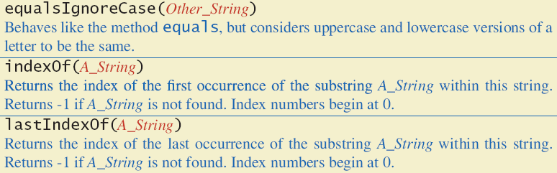
String Methods

Slide 78
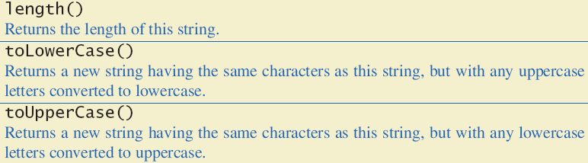
String Methods

Slide 79
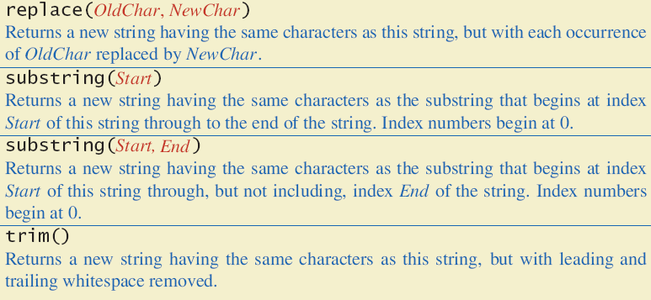
String Methods

Slide 80
String Methods
Program
String message = "Open the pod bay doors"; System.out.println(message.substring(5, 8)); System.out.println(“Hello”.indexOf(“e”)); System.out.println(“HELLO”.toLowerCase());
Output

Slide 81
String Methods
Program
String message = "Open the pod bay doors"; System.out.println(message.substring(5, 8)); System.out.println(“Hello”.indexOf(“e”)); System.out.println(“HELLO”.toLowerCase());
Output
the 1 hello

Slide 82
Example
public class StringDemo
{
public static void main(String[] args)
{
String sentence = "Text processing is hard!";
int position = sentence.indexOf("hard");
System.out.println(sentence);
System.out.println("012345678901234567890123");
System.out.println("The word \"hard\" starts at index " + position);
sentence = sentence.substring(0, position) + "easy!";
sentence = sentence.toUpperCase();
System.out.println("The changed string is:");
System.out.println(sentence);
}
}
Text processing is hard!
012345678901234567890123
The word "hard" starts at index 19
The changed string is:
TEXT PROCESSING IS EASY!
Observe the backslashes ‘\’.

Slide 83
Escape Characters
Printing a string such as
"Java" refers to a language.
requires special handling.
The compiler needs to be told that the quotation marks (") do not signal the start or end of a string.
An escape character (\") is used to do this.
System.out.println("\"Java\" refers to a language.");

Slide 84
Escape Characters
Each escape sequence constitutes a single character,
even though it is typed with two symbols.

Slide 85
Examples
Program
System.out.println("abc\\def"); System.out.println("new\nline"); char singleQuote = '\''; System.out.println(singleQuote);
Output

Slide 86
Examples
Program
System.out.println("abc\\def"); System.out.println("new\nline"); char singleQuote = '\''; System.out.println(singleQuote);
Output
abc\def new line '

Slide 87
Arithmetic

Slide 88
Arithmetic Expressions
Arithmetic expressions can be formed using the following arithmetic operators:
+: addition
-: subtraction
*: multiplication
/: division
%: modulus
These are binary operators (they take 2 arguments).
The arguments (called operands) are themselves expressions (constants, variables, arithmetic expressions).

Slide 89
Arithmetic Expressions
With the exception of %, the operators should be familiar.
However, how they act depends on the data type of the operands.
Consider (a _ b), where _ is one of +, -, *, /.
For the calculation:
If a or b is type double, then the other is converted to double.
Otherwise, if one is type float, then the other is converted to float.
Otherwise, if one is type long, then the other is converted to long.
Otherwise, both are converted to int values.
The result of the calculation has the type converted to.

Slide 90
Arithmetic Expressions
Program | Output
float a = 4.0f; float b = 6.0f; System.out.println(a); System.out.println(b); System.out.println(a/b);
What type does the result have?
What value does the result have?

Slide 91
Arithmetic Expressions
Program | Output
float a = 4.0f; float b = 6.0f; System.out.println(a); System.out.println(b); System.out.println(a/b); | 4.0 6.0 0.6666667
What type does the result have? float
What value does the result have? 0.6666667
When floating point numbers are used, arithmetic proceeds as we would expect.

Slide 92
Arithmetic Expressions
The below sequence can be used as an aid to remember the conversions.
[byte,char,short] → int → long → float → double
Adding an int value to a long value yields a long.
byte, short, char values yield an int value.
(a _ b): If a and b are variables, the actual values they store are not changed (only temporary values are).
Program | Output
int a = 4; double b = 6.0; System.out.println(a); System.out.println(b); System.out.println(a/b); | 4 6.0 0.6666666666666666

Slide 93
Arithmetic Expressions
[byte,char,short] → int → long → float → double
short and short yields:
byte and short yields:
int and short yields:
float and double yields:
float and byte yields:

Slide 94
Arithmetic Expressions
[byte,char,short] → int → long → float → double
short and short yields: int
byte and short yields: int
int and short yields: int
float and double yields: double
float and byte yields: float

Slide 95
Arithmetic Expressions
Program | Output
int a = 4; int b = 6; System.out.println(a); System.out.println(b); System.out.println(a/b);
What type does the result have?
What value does the result have?

Slide 96
Arithmetic Expressions
Program | Output
int a = 4; int b = 6; System.out.println(a); System.out.println(b); System.out.println(b/a); | 4 6 0
What type does the result have? int
What value does the result have? 0
This is an instance of integer division.

Slide 97
Arithmetic Expressions
Program | Output
int a = 38; int b = 10; System.out.println(a); System.out.println(b); System.out.println(a/b);
What type does the result have?
What value does the result have?

Slide 98
Arithmetic Expressions
Program | Output
int a = 38; int b = 10; System.out.println(a); System.out.println(b); System.out.println(a/b); | 38 10 3
What type does the result have? int
What value does the result have? 3
38/10 = 3.8, but this is truncated, not rounded.

Slide 99
Arithmetic Expressions
Program | Output
int a = 38; int b = 10; System.out.println(a); System.out.println(b); System.out.println(a/(double)b);
What type does the result have?
What value does the result have?

Slide 100
Arithmetic Expressions
Program | Output
int a = 38; int b = 10; System.out.println(a); System.out.println(b); System.out.println(a/(double)b; | 38 10 3.8
What type does the result have? double
What value does the result have? 3.8
Explicit casting is permitted in arithmetic expressions.

Slide 101
Arithmetic Expressions
Program | Output
int a = 38; int b = 10; System.out.println(a); System.out.println(b); System.out.println((double)(a/b));
What type does the result have?
What value does the result have?

Slide 102
Arithmetic Expressions
Program | Output
int a = 38; int b = 10; System.out.println(a); System.out.println(b); System.out.println((double)(a/b)); | 38 10 3.0
What type does the result have? double
What value does the result have? 3.0
Where the cast appears is significant.
Here, the cast occurs after the integer division of a/b is performed.

Slide 103
Arithmetic Expressions
Program | Output
int theMaximumInt = 2147483647; int mysteryInt = theMaximumInt + 1; System.out.println(mysteryInt);
What value is printed?

Slide 104
Arithmetic Expressions
Program | Output
int theMaximumInt = 2147483647; int mysteryInt = theMaximumInt + 1; System.out.println(mysteryInt); | -2147483648
What value is printed? -2147483648
This is the minimum value for an int.
Adding 1 to the max value caused the value to “roll over” to the min value.
Similar behavior applies to long values.

Slide 105
Example
Given
What is the data type of the following:
x+y
y+y
y+z
z+w
x+x
short x = 1;
int y = 2;
float z = 3.0f;
double w = 4.0;

Slide 106
Arithmetic Expressions
Nested expressions are computed from the inside out.
To compute (a _ b), where a and b are complex arithmetic expressions, results for a and b are first computed.
These are then used to compute (a _ b).
Program | Output
int a = 4; int b = 6; System.out.println(3.4*(4.5*(a/b)));

Slide 107
Arithmetic Operations
Nested expressions are computed from the inside out.
To compute (a _ b), where a and b are complex arithmetic expressions, results for a and b are first computed.
These are then used to compute (a _ b).
Program | Output
int a = 4; int b = 6; System.out.println(3.4*(4.5*(a/b))); | 0.0

Slide 108
The mod (%) Operator
The mod (%) operator is a binary operator that returns the remainder of integer division.
What is 14/4? 3 with a remainder of 2.
So, 14 % 4 is 2.
Two simple uses, of %:
determining whether an integer is odd or even.
determining whether integer is evenly divisible by another integer.

Slide 109
Parentheses and Precedence
Parentheses are used to delineate operands of the operators.
(cost + tax) * discount
cost + (tax * discount)
Without parentheses, operator precedence rules are used.

Slide 110
Precedence Rules
The binary operators *,/, and %, have higher precedence than binary + and -.
At the same level of precedence, a binary operator on the left acts before a binary operator on the right.
Program | Output
int a = 4; int b = 6; float c = 12; System.out.println(c/a/b);

Slide 111
Precedence Rules
The binary operators *,/, and %, have higher precedence than binary + and -.
At the same level of precedence, a binary operator on the left acts before a binary operator on the right.
Program | Output
int a = 4; int b = 6; float c = 12; System.out.println(c/a/b); | 0.5

Slide 112
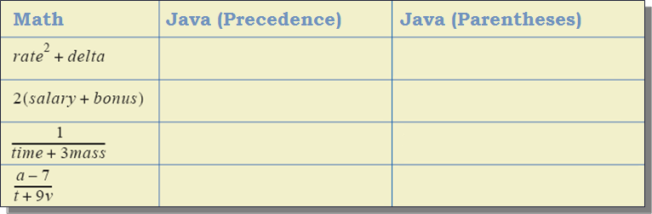
Sample Expressions
Convert these to Java using:
1) parentheses (assume no precedence rules)
2) the precedence rules: *,/, and %, have higher precedence than + and -. Only use parentheses when necessary

Slide 113
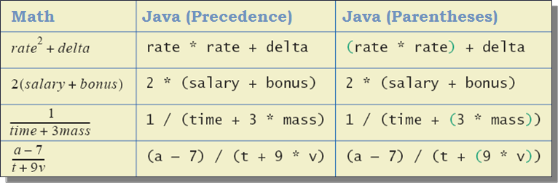
Sample Expressions
Convert these to Java using:
1) parentheses (assume no precedence rules)
2) the precedence rules: *,/, and %, have higher precedence than + and -. Only use parentheses when necessary

Slide 114
Specialized Assignment Operators
Arithmetic operators can be placed to the left of ‘=’.
amount += 5; means the same as amount = amount + 5;
amount -= 5; means the same as amount = amount - 5;
amount *= 5; means the same as amount = amount * 5;
amount /= 5; means the same as amount = amount / 5;
It’s a shorthand that’s useful sometimes.

Slide 115
Increment and Decrement Operators
They increase (or decrease) the value of a variable by 1.
Commonly used; important to recognize.
Equivalent operations:
count++;
count = count + 1;
count--;
count = count - 1;

Slide 116
Case Study:Vending Machine Change
We are going to create a program to calculate a combination of US coins equal to a user-provided value.
Requirements
The user enters an amount between 1 cent and 99 cents.
The input comes from the keyboard.
The program determines the combination of coins.
The program prints out how many coins of each type are needed.
Example: 55 cents can be two quarters and one nickel.

Slide 117
Case Study: Example
Enter a whole number from 1 to 99.
The machine will determine a combination of coins.
87
87 cents in coins:
3 quarters
1 dime
0 nickels
2 pennies

Slide 118
Case Study:
We’ll need variables to store:
The amount provided by the user.
The number of quarters needed.
The number of dimes needed.
The number of nickels needed.
The number of pennies needed.
We’ll make variables for each of these.
Since they’re all integer values, we’ll use int variables.

Slide 119
Case Study:
int amount,quarters, dimes, nickels, pennies;

Slide 120
Important Aside: Algorithms
The notion of an algorithm is crucial to computer science.
An algorithm is a set of instructions for solving a particular problem.
Sorting a list, finding the optimal route between cities, cracking a code, etc.
The instructions are spelled out precisely.
There is no ambiguity about what should be done at any step.

Slide 121
Case Study: Possible Algorithm
Read the amount.
Find the max number of quarters in the amount.
Subtract the value of the quarters from the amount.
Repeat the last two steps for dimes, nickels, and pennies.
Print the original amount and the quantities of each coin.
Good enough?

Slide 122
Case Study,cont.
The algorithm doesn't work properly.
The original value of amount is lost and can’t be printed.
One solution: add another variable to store the original value.
int amount, originalAmount, quarters, dimes, nickles, pennies;

Slide 123
Case Study: Possible Algorithm
Read the amount.
Make a copy of the amount and store it.
Find the max number of quarters in the amount.
Subtract the value of the quarters from the current amount.
Repeat the last two steps for dimes, nickels, and pennies.
Print the original amount and the quantities of each coin.
Good enough?

Slide 124
Case Study
How do we determine the number of quarters in an amount?
What if the value is smaller than $0.25?
If we determine the number of quarters, how do we determine the remaining amount?

Slide 125
Case Study
How do we determine the number of quarters in an amount?
What if the value is smaller than $0.25?
If we determine the number of quarters, how do we determine the remaining amount?
We use integer division (/) to determine the number of quarters (dimes, nickels, or pennies) needed.
We use the mod operator (%) to calculate the remaining amount (for the next step of the program).

Slide 126
Case Study – Test Cases
When finished creating the program (and while creating it), it should be tested with several values.
Extreme cases should be tested (0, near 99,what if user enters invalid number (<0 or >100?)).
Test with values that give zero values for each possible coin denomination.
Testing is an often overlooked but crucial step in the software development cycle.

Slide 127
import java.util.Scanner;
public class ChangeMaker
{
public static void main(String[] args)
{
int amount, originalAmount, quarters, dimes, nickels, pennies;
System.out.println("Enter a whole number from 1 to 99.");
System.out.println("I will find a combination of coins");
System.out.println("that equals that amount of change.");
Scanner keyboard = new Scanner(System.in);
amount = keyboard.nextInt( );
// ???????
}
}

Slide 128
import java.util.Scanner;
public class ChangeMaker
{
public static void main(String[] args)
{
int amount, originalAmount, quarters, dimes, nickels, pennies;
System.out.println("Enter a whole number from 1 to 99.");
System.out.println("I will find a combination of coins");
System.out.println("that equals that amount of change.");
Scanner keyboard = new Scanner(System.in);
amount = keyboard.nextInt( );
originalAmount = amount;
quarters = amount / 25;
amount = amount % 25;
}
}

Slide 129
import java.util.Scanner;
public class ChangeMaker
{
public static void main(String[] args)
{
int amount, originalAmount, quarters, dimes, nickels, pennies;
System.out.println("Enter a whole number from 1 to 99.");
System.out.println("I will find a combination of coins");
System.out.println("that equals that amount of change.");
Scanner keyboard = new Scanner(System.in);
amount = keyboard.nextInt( );
originalAmount = amount;
quarters = amount / 25;
amount = amount % 25;
dimes = amount / 10;
amount = amount % 10;
}
}

Slide 130
import java.util.Scanner;
public class ChangeMaker
{
public static void main(String[] args)
{
int amount, originalAmount, quarters, dimes, nickels, pennies;
System.out.println("Enter a whole number from 1 to 99.");
System.out.println("I will find a combination of coins");
System.out.println("that equals that amount of change.");
Scanner keyboard = new Scanner(System.in);
amount = keyboard.nextInt( );
originalAmount = amount;
quarters = amount / 25;
amount = amount % 25;
dimes = amount / 10;
amount = amount % 10;
nickels = amount / 5;
amount = amount % 5;
pennies = amount;
}
}

Slide 131
import java.util.Scanner;
public class ChangeMaker
{
public static void main(String[] args)
{
int amount, originalAmount, quarters, dimes, nickels, pennies;
System.out.println("Enter a whole number from 1 to 99.");
System.out.println("I will find a combination of coins");
System.out.println("that equals that amount of change.");
Scanner keyboard = new Scanner(System.in);
amount = keyboard.nextInt( );
originalAmount = amount;
quarters = amount / 25;
amount = amount % 25;
dimes = amount / 10;
amount = amount % 10;
nickels = amount / 5;
amount = amount % 5;
pennies = amount;
System.out.println(originalAmount + " cents in coins can be given as:");
System.out.println(quarters + " quarters");
System.out.println(dimes + " dimes");
System.out.println(nickels + " nickels and");
System.out.println(pennies + " pennies");
}
}

Slide 132
Documentation and Style

Slide 133
Documentation and Style
Often, programs are modified over time to respond to new requirements.
Programs which are easy to read and understand are easy to modify.
Even if it will be used only once, you must read it in order to debug it.
It is good practice to document your code extensively, and following naming and other stylistic conventions.

Slide 134
Meaningful Variable Names
A variable's name should suggest its use.
Naming conventions.
Use only letters and digits.
Use camelCase: "Punctuate" using uppercase letters at word boundaries (e.g. taxRate).
Start variables with lowercase letters.
Start class names with uppercase letters.

Slide 135
Comments
The best programs are self-documenting.
Clean style
Well-chosen names
Comments are written into a program as needed to explain the program.
They are useful to the programmer, but they are ignored by the compiler.

Slide 136
Comments
Comments are used in programs to document the code.
A single-line comment begins with //.
Everything after the // to the end of the line is ignored by the compiler.
double radius; //in centimeters

Slide 137
Comments
A multiline comment begins with /* and end with */.
/*
This program should only
be used on alternate Thursdays,
except during leap years, when it should
only be used on alternate Tuesdays.
*/
Everything in-between is ignored by the compiler.

Slide 138
You should use Comments
Begin each program file with an explanatory comment:
What the program does
The name of the author
Contact information for the author
Date of the last modification.
Provide comments the reader will need in order to understand the program.
A header is given to you in the project description. Use this and fill it out with your information.

Slide 139
import java.util.Scanner;
/**
Program to compute area of a circle.
Author: Jane Q. Programmer.
E-mail Address: janeq@somemachine.etc.etc.
Programming Assignment 2.
Last Changed: October 7, 2008.
*/
public class CircleCalculation
{
public static void main(String[] args)
{
double radius; //in inches
double area; //in square inches
Scanner keyboard = new Scanner(System.in);
System.out.println("Enter the radius of a circle in inches:");
radius = keyboard.nextDouble( );
area = 3.14159 * radius * radius;
System.out.println("A circle of radius " + radius + " inches");
System.out.println("has an area of " + area + " square inches.");
}
}

Slide 140
Indentation
Java programs are, by nature, nested.
Indentation should communicate nesting clearly.
White spaces (spaces, tabs, carriage returns) are typically unimportant to program execution,
But they do improve readability.
4 spaces (or a tab) for each level of indentation is common.
Regardless, be consistent.

